Slide 1
Algorithms for Division
Division can be implemented using either a restoring or a non-restoring algorithm. An inner loop to perform multiple subtractions must be incorporated into the algorithm.
10
11 ) 1000
11_
10

Slide 2
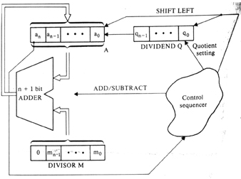
5) Algorithms for Division
A logic circuit arrangement implements the restoring-division technique

Slide 3
A restoring-division example
Initially 0 0 0 0 0 1 0 0 0
0 0 0 1 1
Shift 0 0 0 0 1 0 0 0
Subtract 1 1 1 0 1
Set q₀ 1 1 1 1 0
Restore 1 1
0 0 0 0 1 0 0 0 0
Shift 0 0 0 1 0 0 0 0
Subtract 1 1 1 0 1
Set q₀ 1 1 1 1 1
Restore 1 1
0 0 0 1 0 0 0 0 0
Shift 0 0 1 0 0 0 0 0
Subtract 1 1 1 0 1
Set q₀ 0 0 0 1 0 0 0 0 1
Shift 0 0 0 1 0 0 0 1
Subtract 1 1 1 0 1
Set q₀ 1 1 1 1 1
Restore 1 1
0 0 0 1 0 0 0 1 0
First cycle
Second cycle
Third cycle
Fourth cycle
Quotient
remainder

Slide 4
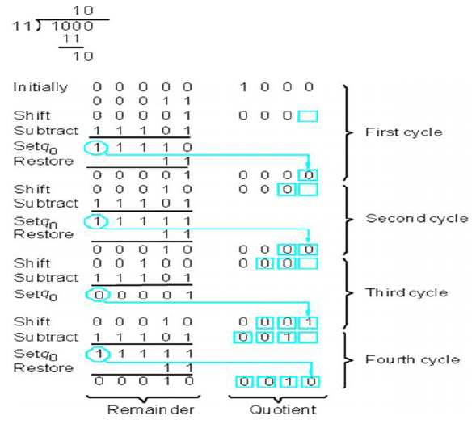

Slide 5
5) Algorithms for Division
The restoring-division algorithm:
S1: DO n times
Shift A and Q left one binary position.
Subtract M from A, placing the answer back in A.
If the sign of A is 1, set q₀ to 0 and add M back to A (restore A); otherwise, set q₀ to 1.

Slide 6
The restoring-division algorithm can be improved by avoiding the need for restoring A after an unsuccessful subtraction. Subtraction is said to be unsuccessful if the result is negative.

Slide 7
5) Algorithms for Division
The non-restoring division algorithm:
S1: Do n times
If the sign of A is 0, shift A and Q left one binary position and subtract M from A; otherwise, shift A and Q left and add M to A.
S2: If the sign of A is 1, add M to A.

Slide 8
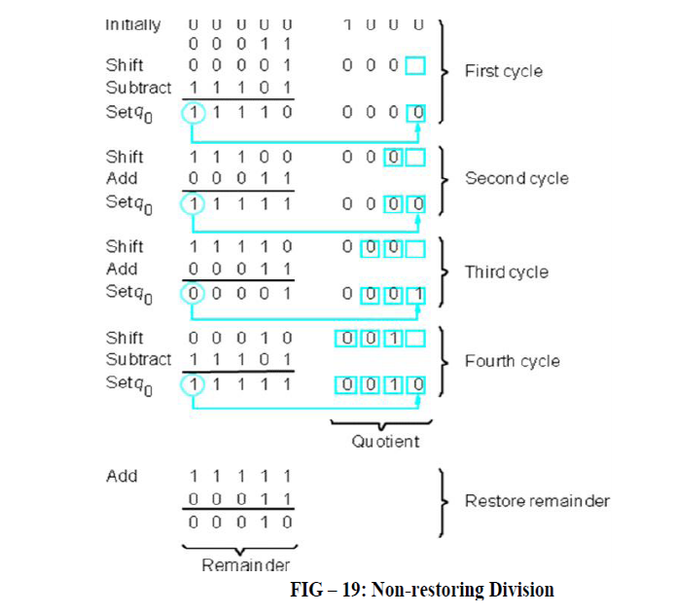

Slide 9
References:
Computer Systems Organization & Architecture, Addison Wesley Longman, Inc., 2001
Introduction to Computer Organization 4th Edition. V.Carl hamacher. 1998
http:// www.sfxavier.ac.uk/computing/bcd/bcd1.htm
http:// www.awl.com/carpinelli
Thank you

